Slide 1
TV Shop Inventory Database
Bijan Bozorgzad, John Aye, Max Gastelum, Daniel Mendoza, Joshua Reyes, Kimberly Cruz

Slide 2
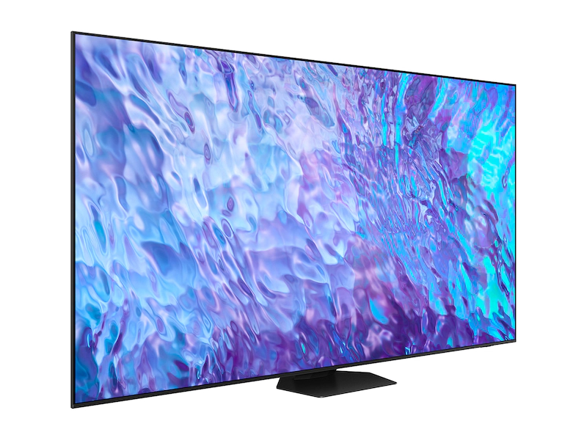
Brief Description
Our inventory database serves the purpose of tracking the TV Models in the warehouse and finding information about each TV Model based off different factors. For example, based on TV Type, Brand, or Country.
Notes:
John

Slide 3
Business Rules
At our TV shop, we manage our inventory to offer high-quality televisions. While we don’t directly interact with shoppers, our internal database ensures smooth operations. Here’s how we organize our data:
Our diverse TV Types are identified by TV Type ID and encompass various Sizes, Pixel Technologies (LED, LCD, OLED, QLED, Mini-LED), Resolution, Viewing Angles (curved or straight), and smart capabilities (OS options like Android TV, webOS, Tizen).
Each TV Type can include multiple TV Models. For TV Models we record the Model Number, Price, and Quantity.
We carry TVs from multiple Brands. Brands are identified by their Brand ID and their Brand Name is recorded. Information about what Country they come from is also recorded, like their Country ID and Name.
Notes:
John

Slide 4
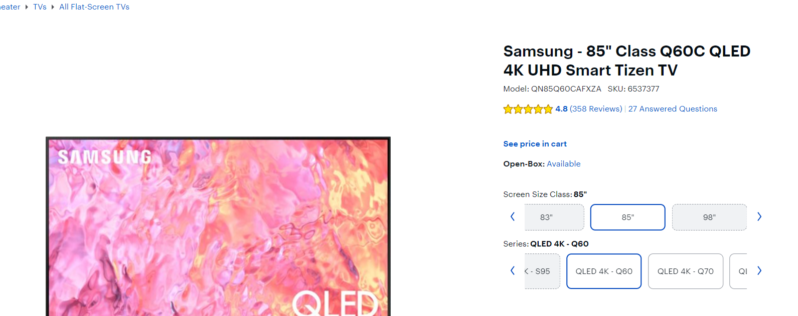
Relationships
Brand - Country (1:M): A Country can have multiple Brands or no Brands. A Brand can only come from one country.
Brand - TV Model (1: M): A TV Model can be produced by only one Brand. A Brand can create many TV Models.
TV Model - TV Type (1:M): A TV Model can belong to 1 and only 1 TV Type but each TV Type can be in many TV Models.
Notes:
John

Slide 5
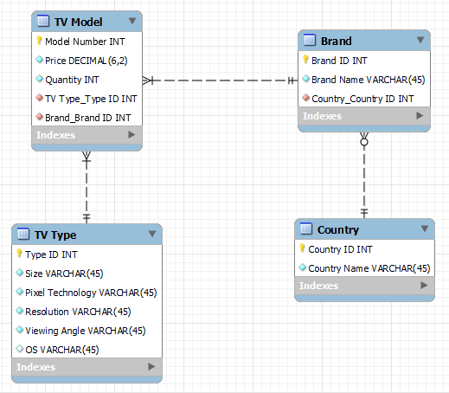
Initial ERD:
Notes:
John

Slide 6
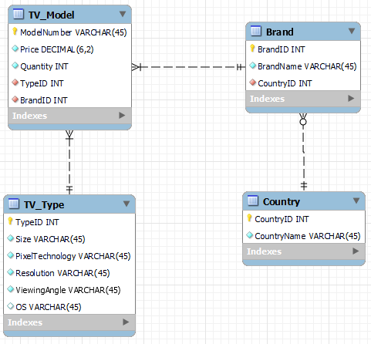
Revised ERD to create schema:
Notes:
John

Slide 7
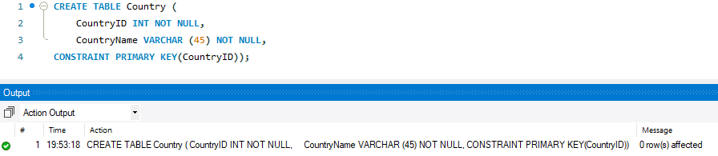
Tables - Country
Notes:
Bijan
CREATE TABLE Country (
CountryID INT NOT NULL,
CountryName VARCHAR (45) NOT NULL,
CONSTRAINT PRIMARY KEY(CountryID));

Slide 8
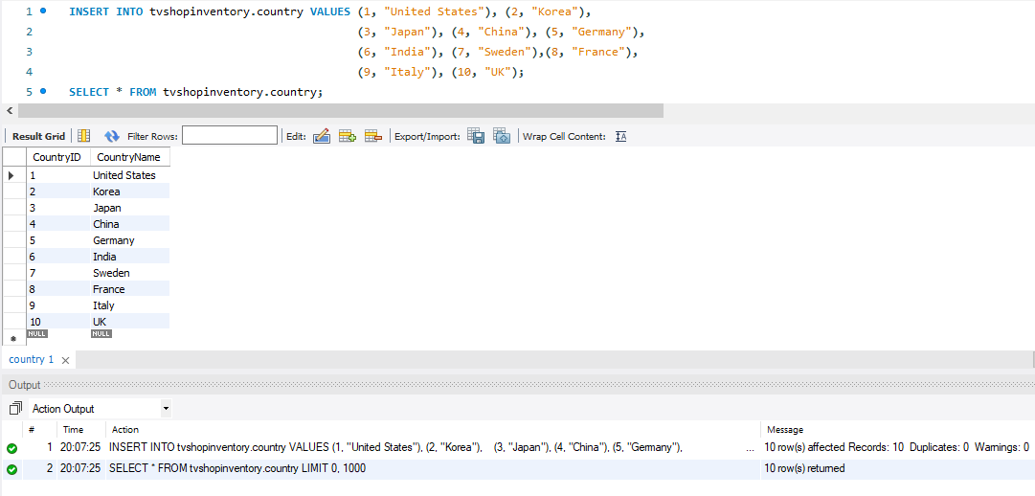
Populating Table - Country
Notes:
Bijan
INSERT INTO tvshopinventory.country VALUES (1, "United States"), (2, "Korea"),
(3, "Japan"), (4, "China"), (5, "Germany"),
(6, "India"), (7, "Sweden"),(8, "France"),
(9, "Italy"), (10, "UK");
SELECT * FROM tvshopinventory.country;

Slide 9
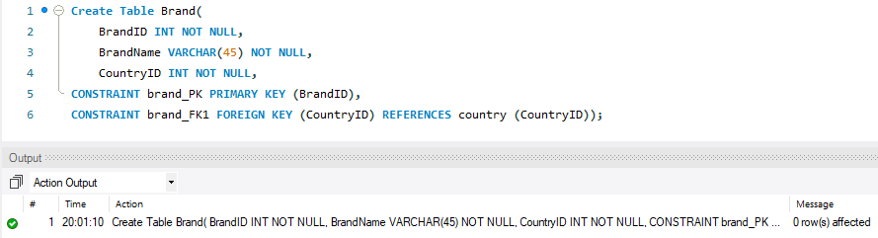
Tables - Brand
Notes:
Bijan
CREATE TABLE TV_Type(
TypeID INT NOT NULL,
Size VARCHAR(45) NOT NULL,
PixelTechnology VARCHAR(45) NOT NULL,
Resolution VARCHAR(45) NOT NULL,
ViewingAngle VARCHAR(45) NOT NULL,
OS VARCHAR(45) NULL,
CONSTRAINT TV_Type_PK PRIMARY KEY (TypeID))

Slide 10
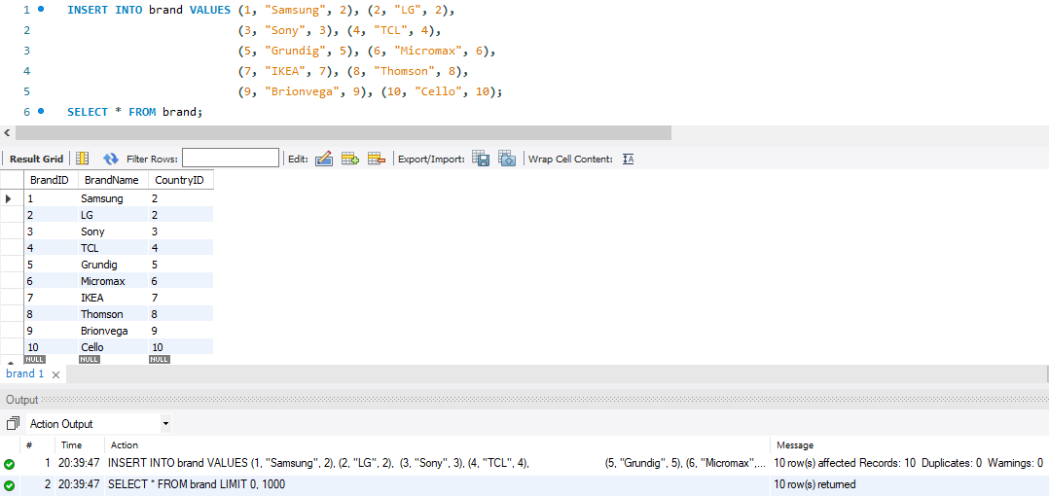
Populating Table - Brand
Notes:
Bijan
INSERT INTO brand VALUES (1, "Samsung", 2), (2, "LG", 2),
(3, "Sony", 3), (4, "TCL", 4),
(5, "Grundig", 5), (6, "Micromax", 6),
(7, "IKEA", 7), (8, "Thomson", 8),
(9, "Brionvega", 9), (10, "Cello", 10);
SELECT * FROM brand;

Slide 11
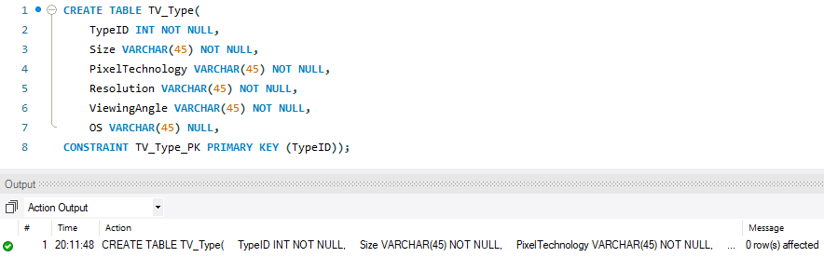
Tables - TV_Type
Notes:
Bijan
CREATE TABLE TV_Type(
TypeID INT NOT NULL,
Size VARCHAR(45) NOT NULL,
PixelTechnology VARCHAR(45) NOT NULL,
Resolution VARCHAR(45) NOT NULL,
ViewingAngle VARCHAR(45) NOT NULL,
OS VARCHAR(45) NULL,
CONSTRAINT TV_Type_PK PRIMARY KEY (TypeID))

Slide 12
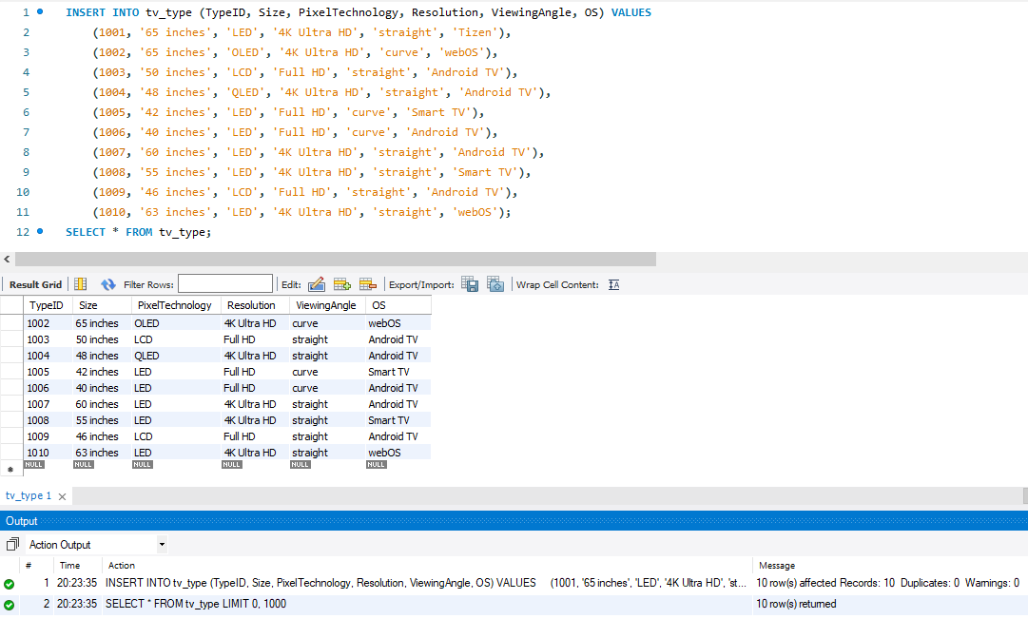
Populating Table - TV_Type
Notes:
Bijan
INSERT INTO tv_type (TypeID, Size, PixelTechnology, Resolution, ViewingAngle, OS) VALUES
(1001, '65 inches', 'LED', '4K Ultra HD', 'straight', 'Tizen'),
(1002, '65 inches', 'OLED', '4K Ultra HD', 'curve', 'webOS'),
(1003, '50 inches', 'LCD', 'Full HD', 'straight', 'Android TV'),
(1004, '48 inches', 'QLED', '4K Ultra HD', 'straight', 'Android TV'),
(1005, '42 inches', 'LED', 'Full HD', 'curve', 'Smart TV'),
(1006, '40 inches', 'LED', 'Full HD', 'curve', 'Android TV'),
(1007, '60 inches', 'LED', '4K Ultra HD', 'straight', 'Android TV'),
(1008, '55 inches', 'LED', '4K Ultra HD', 'straight', 'Smart TV'),
(1009, '46 inches', 'LCD', 'Full HD', 'straight', 'Android TV'),
(1010, '63 inches', 'LED', '4K Ultra HD', 'straight', 'webOS');
SELECT * FROM tv_type;

Slide 13
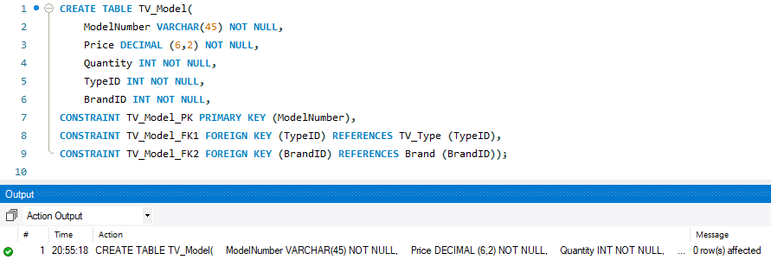
Tables - TV_Model
Notes:
Bijan
CREATE TABLE TV_Model(
ModelNumber VARCHAR(45) NOT NULL,
PRICE DECIMAL (6,2) NOT NULL,
Quantity INT NOT NULL,
TypeID INT NOT NULL,
BrandID INT NOT NULL,
CONSTRAINT TV_Model_PK PRIMARY KEY (ModelNumber),
CONSTRAINT TV_Model_FK1 FOREIGN KEY (TypeID) REFERENCES TV_Type (TypeID),
CONSTRAINT TV_Model_FK2 FOREIGN KEY (BrandID) REFERENCES Brand (BrandID));

Slide 14
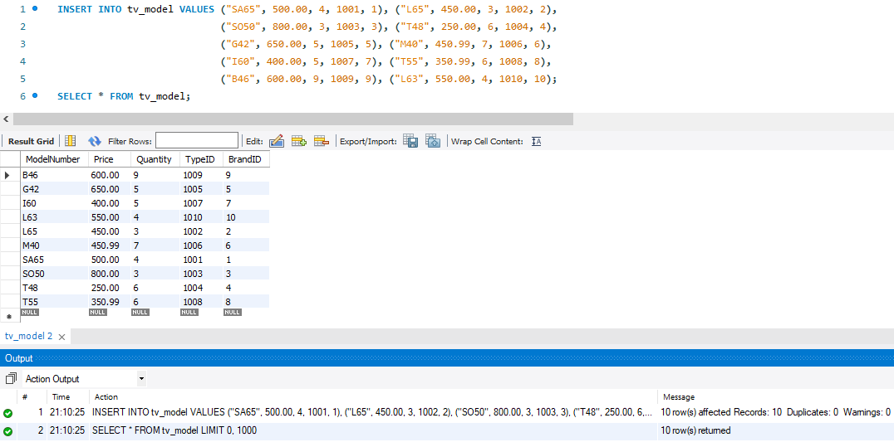
Populating Table - TV_Model
Notes:
Bijan
INSERT INTO tv_model VALUES ("SA65", 500.00, 4, 1001, 1), ("L65", 450.00, 3, 1002, 2),
("SO50", 800.00, 3, 1003, 3), ("T48", 250.00, 6, 1004, 4),
("G42", 650.00, 5, 1005, 5), ("M40", 450.99, 7, 1006, 6),
("I60", 400.00, 5, 1007, 7), ("T55", 350.99, 6, 1008, 8),
("B46", 600.00, 9, 1009, 9), ("L63", 550.00, 4, 1010, 10);
SELECT * FROM tv_model;

Slide 15
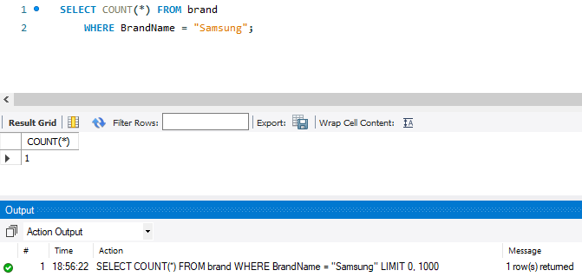
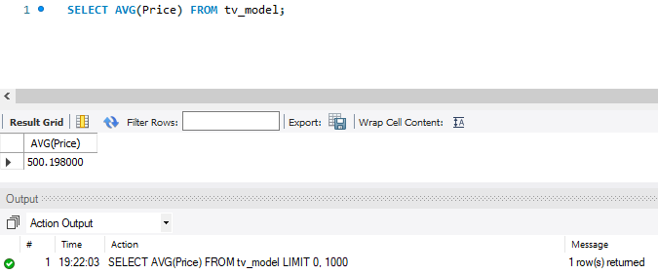
Queries
Total number of TV Models from brand Samsung.
Average price for all TV models.
Notes:
Daniel
SELECT COUNT(*) FROM brand
WHERE BrandName = “Samsung”;
SELECT AVG(Price) FROM tv_model;

Slide 16
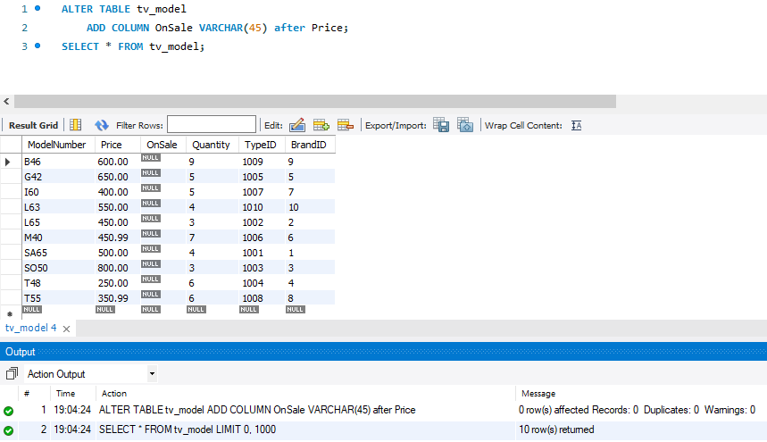
Queries
Add new column ‘On_Sale’ with the type VARCHAR(45) after the ‘price’ column to the ‘tv_model’ table.
Notes:
Daniel
ALTER TABLE tv_model
ADD COLUMN OnSale VARCHAR(45) after Price;
SELECT * FROM tv_model;

Slide 17
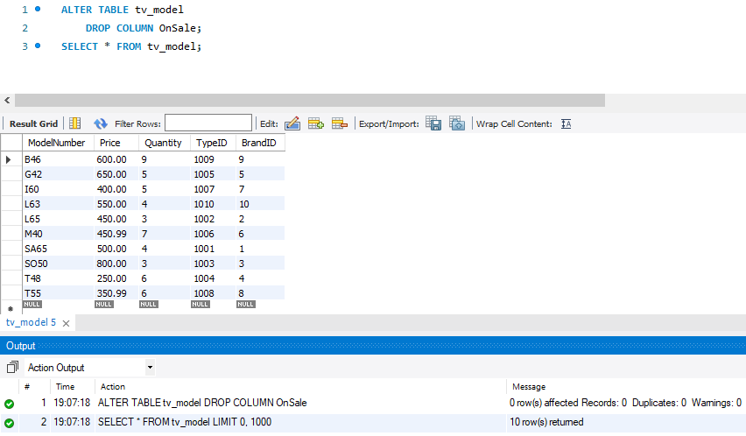
Queries
Drop the ‘on_sale’ column from the ‘tv_model’.
Notes:
ALTER TABLE tv_model
DROP COLUMN OnSale;
SELECT * FROM tv_model;

Slide 18
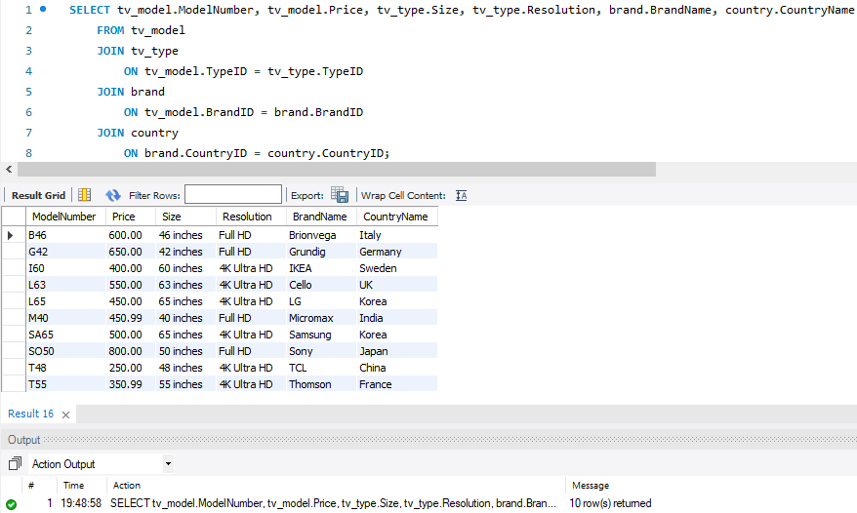
Queries
Select model number, price, size, resolution, brand name, and country name for TV models.
Notes:
SELECT tv_model.ModelNumber, tv_model.Price, tv_type.Size, tv_type.Resolution, brand.BrandName, country.CountryName
FROM tv_model
JOIN tv_type
ON tv_model.TypeID = tv_type.TypeID
JOIN brand
ON tv_model.BrandID = brand.BrandID
JOIN country
ON brand.CountryID = country.CountryID;

Slide 19
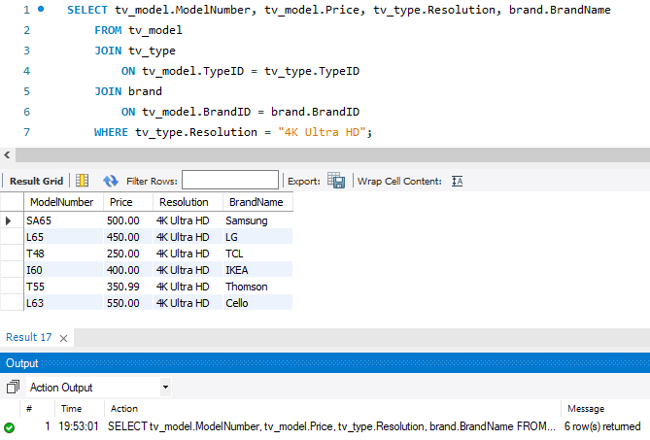
Queries
Select model number, price, brand name, and resolution for TV models with 4K Ultra HD resolution.
Notes:
Max
SELECT tv_model.ModelNumber, tv_model.Price, tv_type.Resolution, brand.BrandName
FROM tv_model
JOIN tv_type
ON tv_model.TypeID = tv_type.TypeID
JOIN brand
ON tv_model.BrandID = brand.BrandID
WHERE tv_type.Resolution = "4K Ultra HD";

Slide 20
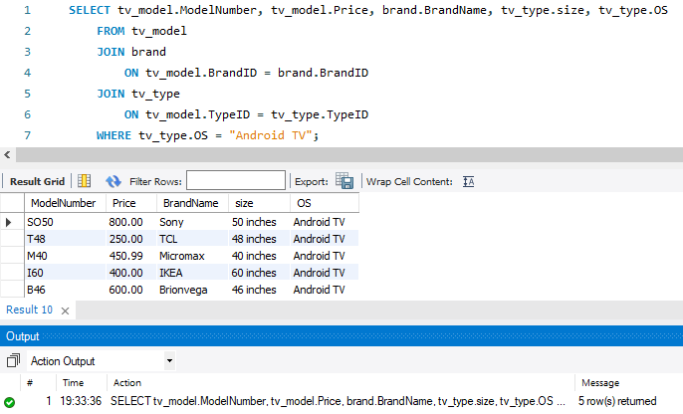
Queries
Select model number, price, brand name, size, and OS for TV models with Android TV OS.
Notes:
Max
SELECT tv_model.ModelNumber, tv_model.Price, brand.BrandName, tv_type.size, tv_type.OS
FROM tv_model
JOIN brand
ON tv_model.BrandID = brand.BrandID
JOIN tv_type
ON tv_model.TypeID = tv_type.TypeID
WHERE tv_type.OS = "Android TV";

Slide 21
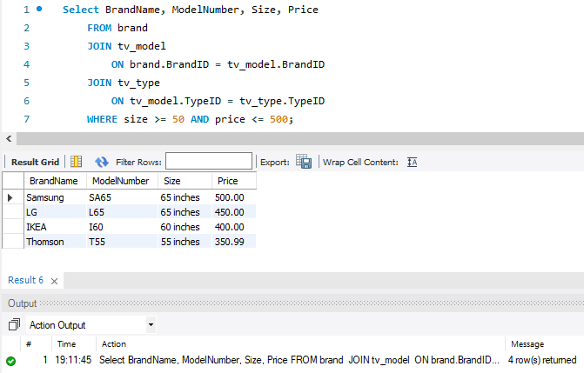
Queries
Select Brand, TV Model, Price, and Size that have size >= 50 and price <= 500.
Notes:
Joshua
Select BrandName, ModelNumber, Size, Price
FROM brand
JOIN tv_model
ON brand.BrandID = tv_model.BrandID
JOIN tv_type
ON tv_model.TypeID = tv_type.TypeID
WHERE size >= 50 AND price <= 500;

Slide 22
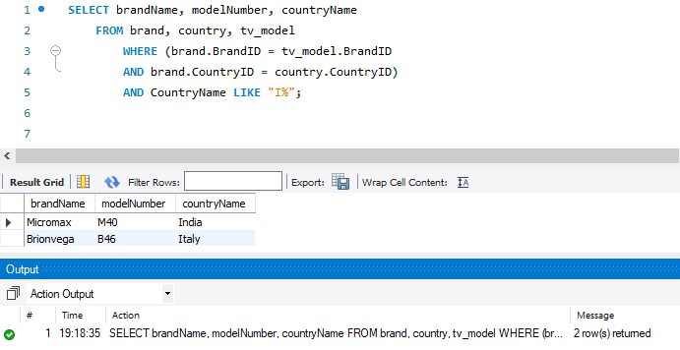
Queries
TV Models and Brands, Country that come from the country that start with I.
Notes:
Joshua
SELECT brandName, modelNumber, countryName
FROM brand, country, tv_model
WHERE (brand.BrandID = tv_model.BrandID
AND brand.CountryID = country.CountryID)
AND CountryName LIKE "I%";

Slide 23
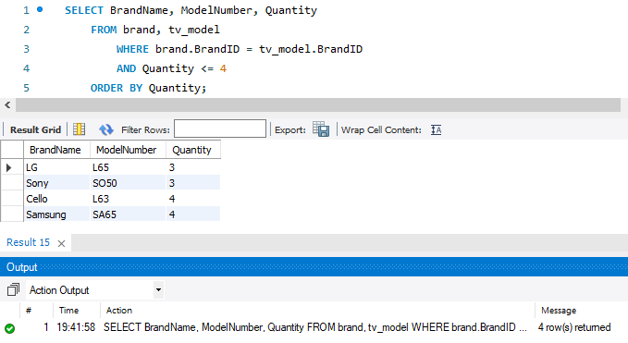
Queries
Find Brand and TV Models that have low stock (<=4 in inventory).
Notes:
John
SELECT BrandName, ModelNumber, Quantity
FROM brand, tv_model
WHERE brand.BrandID = tv_model.BrandID
AND Quantity <= 4
ORDER BY Quantity;

Slide 24
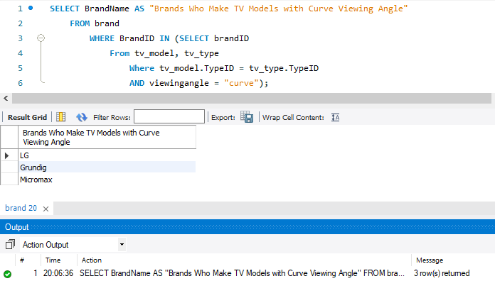
Queries
Subquery name of brands that have a TV with curved viewing angle
Notes:
John
SELECT BrandName AS "Brands Who Make TV Models with Curve Viewing Angle"
FROM brand
WHERE BrandID IN (SELECT brandID
From tv_model, tv_type
Where tv_model.TypeID = tv_type.TypeID
AND viewingangle = "curve");

Slide 25
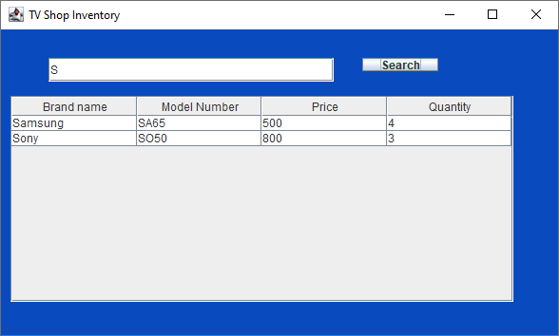
JDBC
Notes:
Kimberly

Slide 26

JDBC
Notes:
Kimberly

Slide 27

JDBC
Notes:
Kimberly

Slide 28

JDBC
Notes:
Kimberly

Slide 29
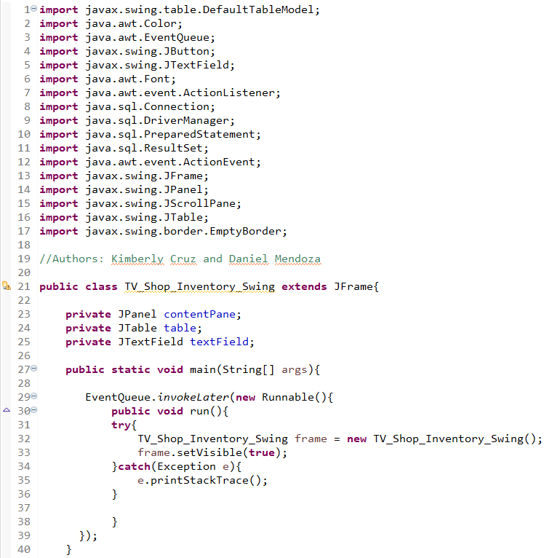
JDBC Code
Notes:
Kimberly

Slide 30
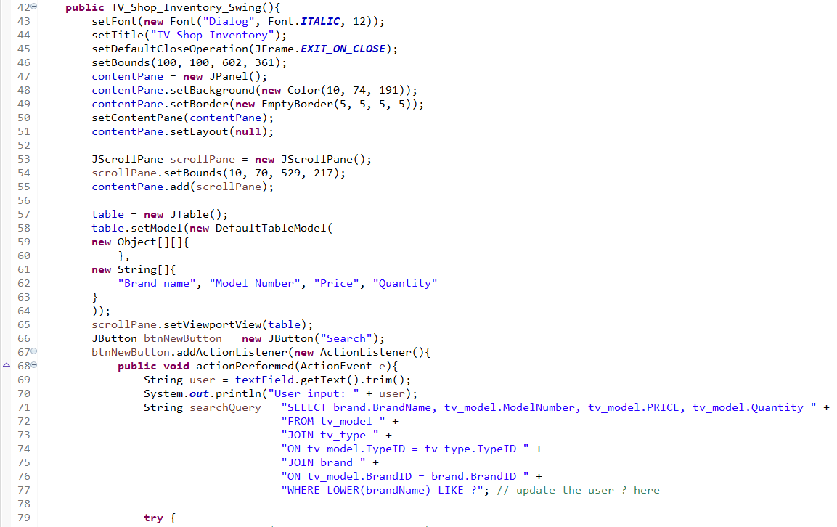
JDBC Code
Notes:
Kimberly

Slide 31
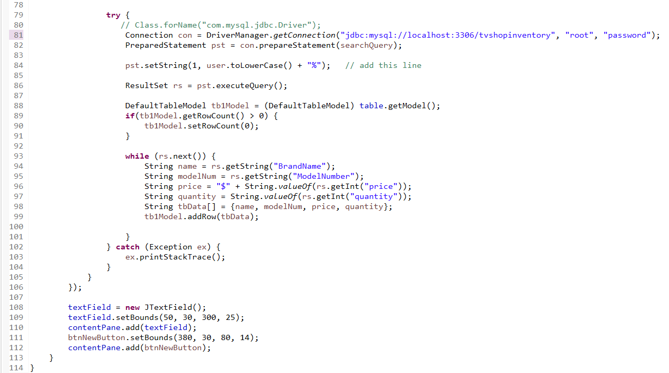
JDBC Code
Notes:
Kimberly

Slide 32
After this slide is the forward engineering example of our schema.

Slide 33
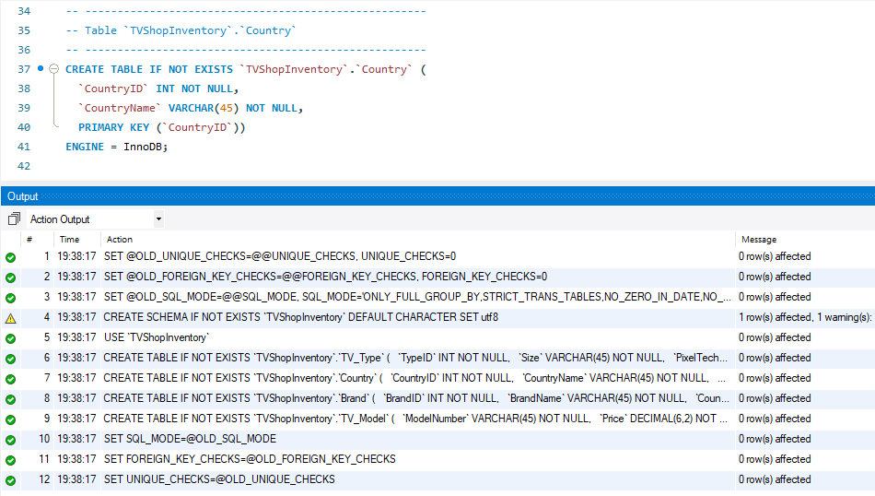
Forward Engineered Tables - Country

Slide 34
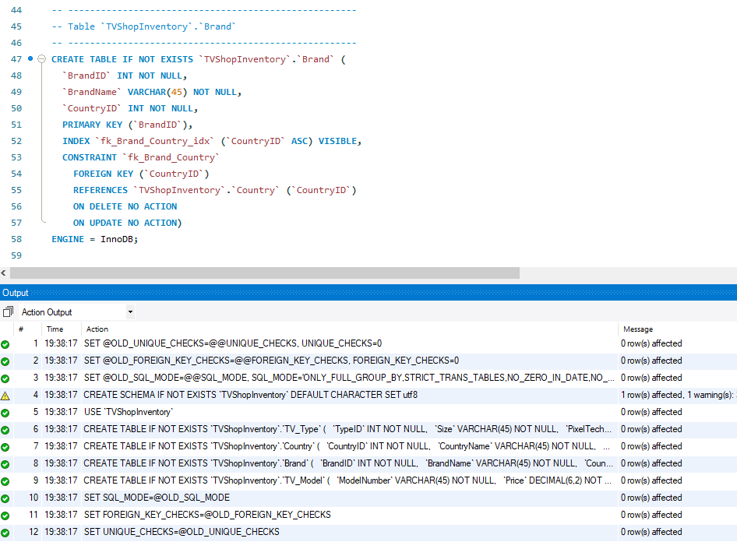
Forward Engineered Tables - Brand

Slide 35
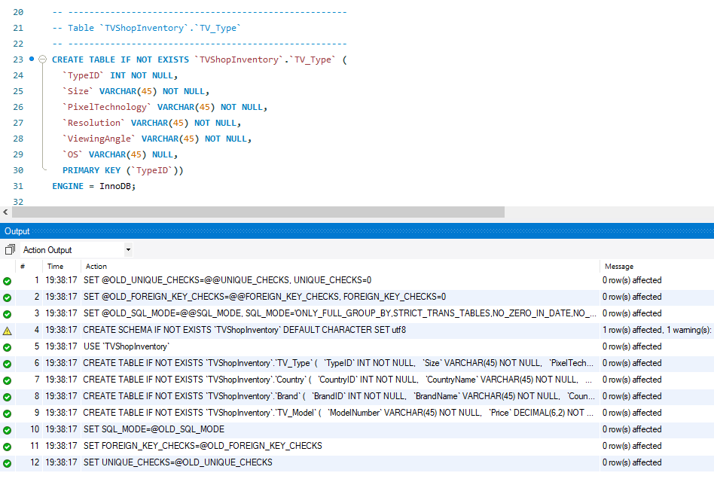
Forward Engineered Tables - TV_Type

Slide 36
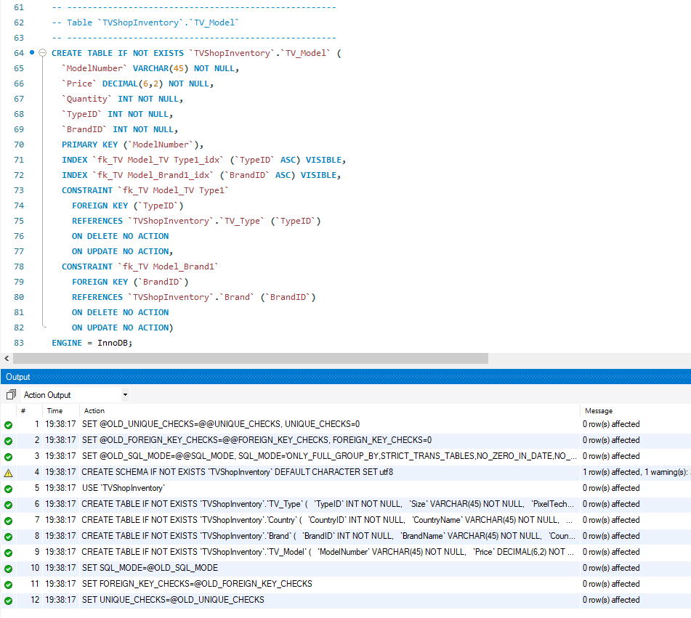
Forward Engineered Tables - TV_Model

